Slide 1
Virtual Memory
Dr. Manmath N. Sahoo
Dept. of CSE, NIT Rourkela

Slide 2
Virtual Memory
Virtual Memory is a technique that allows the execution of processes that are not completely in main memory.
Motivation
Conditional execution:
either 2 pages of if block will be loaded
or 2 pages of else block.
Error handling codes in programs are seldom executed.
Even though all the pages are needed, they are not needed at the same time.
If(condition){
----
| |
----
| |
----
}
Else{
----
| |
----
| |
----
}

Slide 3
Virtual Memory
Advantages:
A process would no longer be constrained by the amount of available physical memory.
Increases degree of multi-programming.
Better CPU utilization and throughput.
Less I/O overhead

Slide 4
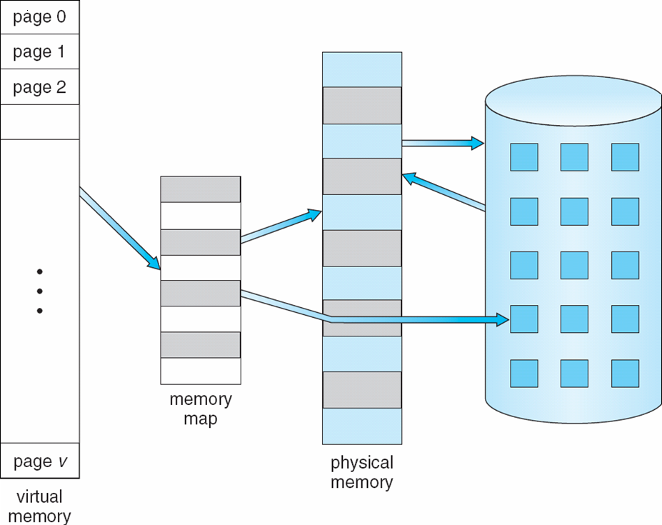
Virtual Memory That is Larger Than Physical Memory

Slide 5
Demand Paging
Bring a page into memory only when it is needed.
Page is needed ⇒ reference to it
invalid reference (not-in-memory) ⇒ bring to memory

Slide 6
Valid-Invalid Bit
With each page table entry a valid–invalid bit is associated (1 ⇒ in-memory, 0 ⇒ not-in-memory)
Initially valid–invalid bit is set to 0 on all entries
During address translation, if valid–invalid bit in page table entry is 0 ⇒ page fault

Slide 7
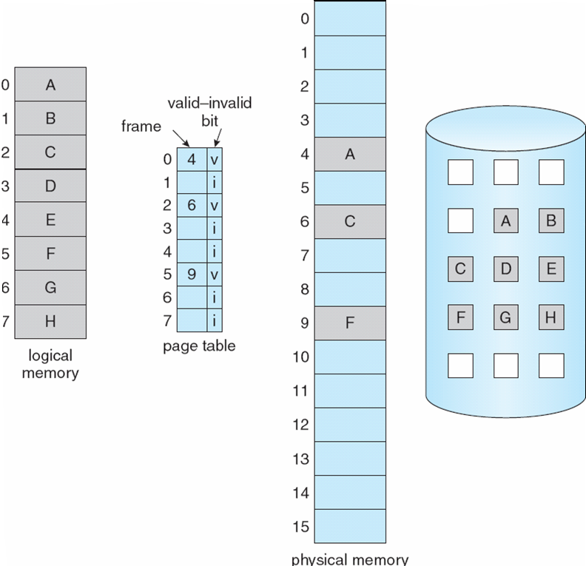
Page Table When Some Pages Are Not in Main Memory

Slide 8
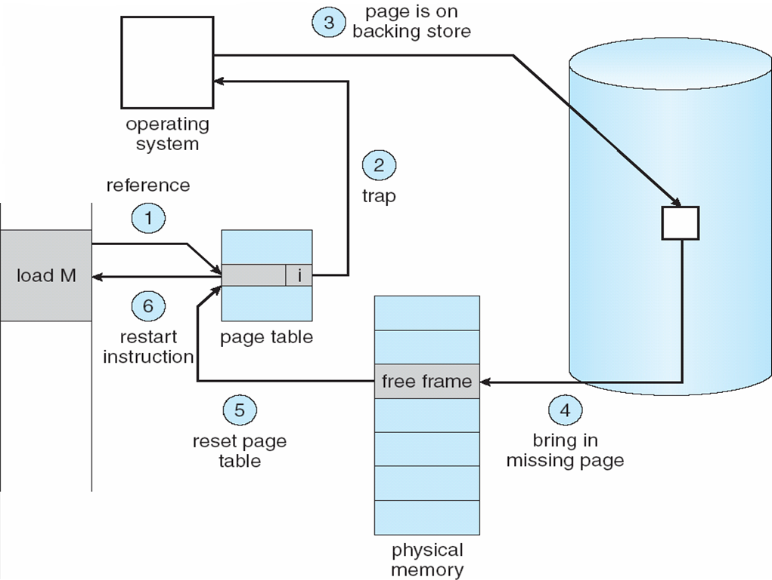
Steps in Handling a Page Fault

Slide 9
Copy-on-Write
Copy-on-Write allows both parent and child processes to initially share the same pages in memory
If either process modifies a shared page, only then is the page copied
It allows more efficient process creation as only modified pages are copied

Slide 10
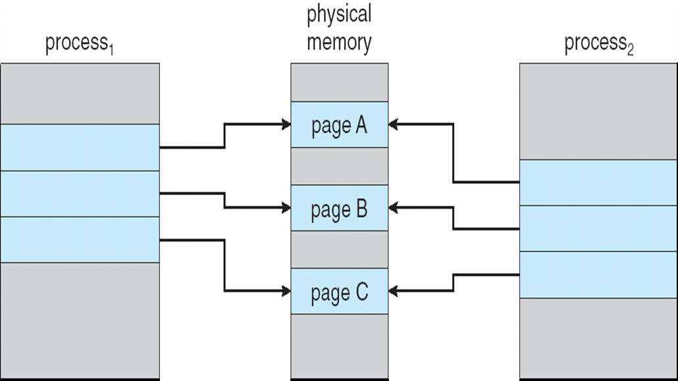
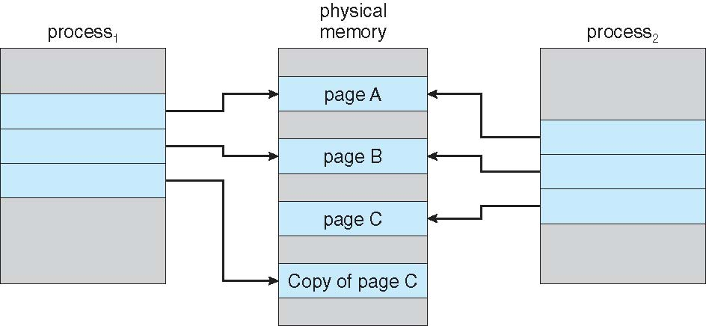
Copy-on-Write
Before Process 1 Modifies Page C
After Process 1 Modifies Page C

Slide 11
What happens if there is no free frame?
Page replacement – find some page in memory, but not really in use, swap it out
algorithm
performance – want an algorithm which will result in minimum number of page faults
Use modify (dirty) bit to reduce overhead of page transfers – only modified pages are written to disk

Slide 12
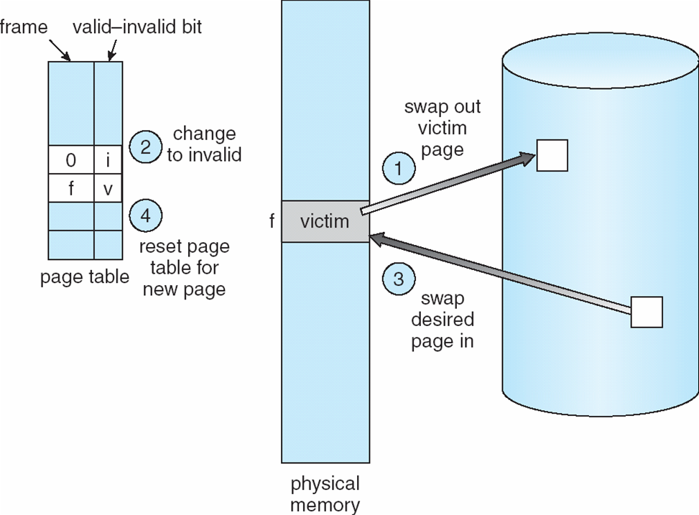
Page Replacement

Slide 13
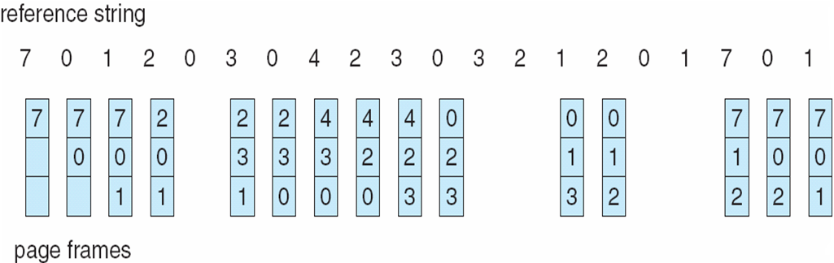
First-In-First-Out (FIFO) Algorithm
Replace page that has come first.
Total page faults = 15

Slide 14
FIFO Algorithm: Belady’s Anomaly
Reference string: 1, 2, 3, 4, 1, 2, 5, 1, 2, 3, 4, 5
3 frames – 9 page faults
4 frames – 10 page faults

Slide 15
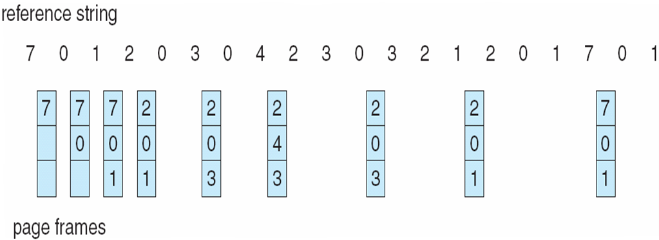
Optimal Algorithm
Replace page that will not be used for longest period of time
How do you know this?
Used for measuring how well your algorithm performs

Slide 16
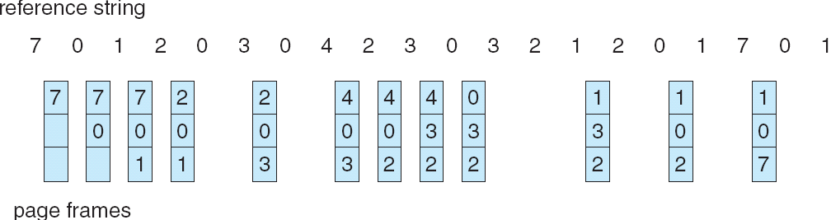
Least Recently Used (LRU) Algorithm
Replace the page that has not been used for longest period of time.

Slide 17
LRU Implementation
Counter implementation
Every page entry has a counter; every time page is referenced, copy the clock into the counter
Logical counter ticks with every page reference
Replace a valid page with smallest counter

Slide 18
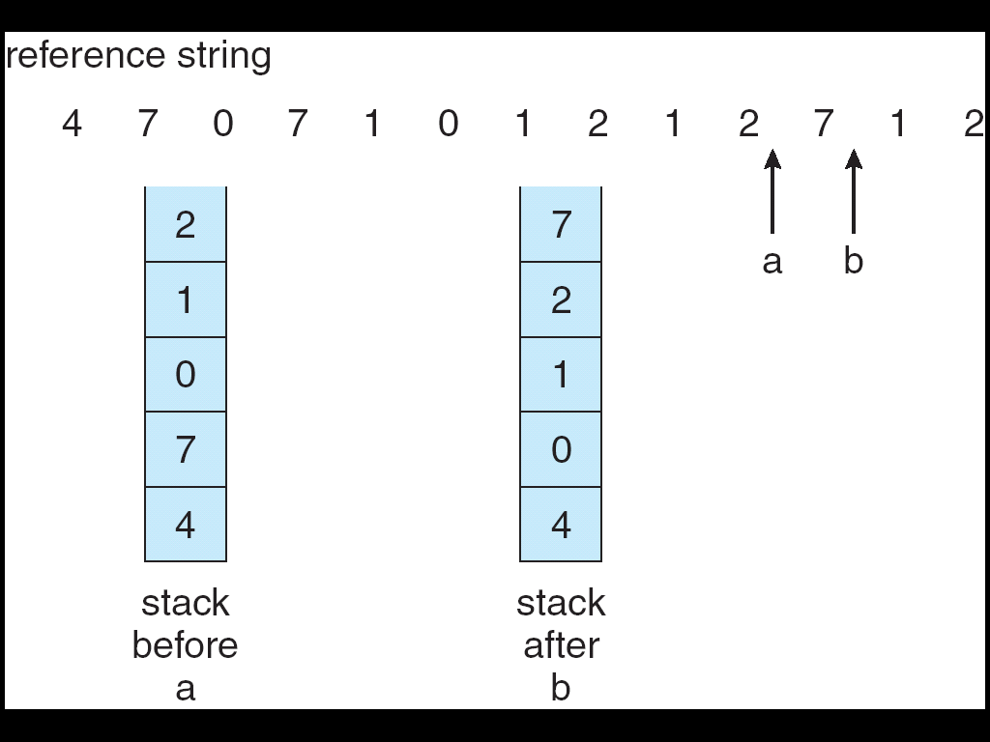
LRU Implementation
Modified Stack implementation
Push at top only, Pop from anywhere
Page referenced ⇒ on the memory ⇒ move it to the top
LRU page will be at the bottom always

Slide 19
Additional Reference bits Algorithm
Keep a reference/use bit and 7-bit reference history for each entry in PMT.
For every page reference, update the reference bit of that page
At regular intervals (say 50ns)
Perform right shift to the history bits, discarding the LSB
Push reference bit value to MSB of history bits
Reset reference bit to 0
Thus 1-byte represents the status of the page usage in 8 intervals.
00000000 – The page has not been used for 8 intervals
11111111 – The page is used at least once in each interval
11000100 is more recently used than 01110111
So, lowest number is the LRU page

Slide 20
Additional Reference bits Algorithm
3, 2, 3, T, 8, 0, 3, T, 3, 0, 2, T, 6, 3, 4, 7
T marks the end of each time interval
During 1st interval
At the end of 1st interval

Slide 21
Additional Reference bits Algorithm
3, 2, 3, T, 8, 0, 3, T, 3, 0, 2, T, 6, 3, 4, 7
During 2nd interval
At the end of 2nd interval

Slide 22
Additional Reference bits Algorithm
3, 2, 3, T, 8, 0, 3, T, 3, 0, 2, T, 6, 3, 4, 7
During 3rd interval
At the end of 3rd interval

Slide 23
Additional Reference bits Algorithm
3, 2, 3, T, 8, 0, 3, T, 3, 0, 2, T, 6, 3, 4, 7
During 4th interval, after 6, 3
During 4th interval, after 6, 3, 4
Page 4 replaced 8 with U bits 0010

Slide 24
Additional Reference bits Algorithm
3, 2, 3, T, 8, 0, 3, T, 3, 0, 2, T, 6, 3, 4, 7
During 4th interval, after 6, 3, 4, 7
If there are more victim pages with same U bits then chose FIFO
Page 7 replaced 2 with U bits 0101

Slide 25
Second Chance Algorithm
Uses
a reference/used bit
NO history bits
FIFO
Search FIFO pages circularly
If FIFO page’s used bit is 0 then
replace it
Else
give that FIFO page a second chance
clear its used bit
goto next FIFO page

Slide 26
Second Chance Algorithm

Slide 27
Second Chance Algorithm

Slide 28
Second Chance Algorithm

Slide 29
Second Chance Algorithm

Slide 30
Second Chance Algorithm

Slide 31
Enhanced Second Chance Algorithm
Considers reference/used bit and dirty/modified bit
Four cases, based on (R,M), the pair:
(R,M) = (0,0) neither recently used nor modified -- best to replace
(R,M) = (0,1) not recently used but modified -- second choice
(R,M) = (1,0) recently used but not modified -- third choice
(R,M) = (1,1) recently used and modified -- fourth choice

Slide 32
Enhanced Second Chance Algorithm
If class-0 page then use it
If class-1 page then record first instance
Else clear R bit and go to next FIFO page
If scan is completed then
If class-1 page was recorded then use that recorded instance
Else repeat another scan

Slide 33
Counting based page replacements
Keep a counter of the number of references that have been made to each page
LFU Algorithm: replaces page with smallest count
MFU Algorithm: based on the argument that the page with the smallest count was probably just brought in and has yet to be used

Slide 34
Allocation of Frames
Each process needs minimum number of frames
Otherwise high page fault rate => slow execution
Two major allocation schemes
Fixed allocation
Priority allocation

Slide 35
Fixed Allocation
Equal allocation – For example, if there are m=100 frames and n=5 processes, give each process 20 frames.
Smaller processes waste frames.
Proportional allocation – Allocate according to the size of process

Slide 36
Priority Allocation
Use a proportional allocation scheme using priorities rather than size

Slide 37
Global vs. Local Allocation
Global replacement – process selects a replacement frame from the set of all frames; one process can take a frame from another
Local replacement – each process selects from only its own set of allocated frames
In local replacement, no. of allocated frames is not affected by other processes => page fault rate is not affected by other processes.

Slide 38
Thrashing
P_{high} steals frames from P_{low}
Page fault rate increases for P_{low}
P_{high} steals more frames from P_{low}
Page fault rate further increases for P_{low}
If a process does not have “enough” frames, the page-fault rate is very high. This leads to:
low CPU utilization
operating system thinks that it needs to increase the degree of multiprogramming
another process added to the system
Thrashing ≡ a process is busy swapping pages in and out

Slide 39
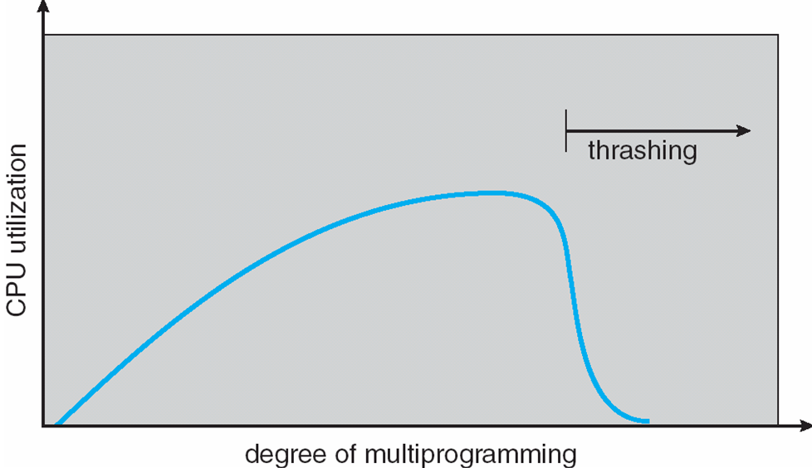
Thrashing

Slide 40
Demand Paging and Thrashing
Why does demand paging work? Locality model
Process migrates from one locality to another
Currently executing main function (locality-1), may call sqrt function (locality-2)
Localities may overlap
both the functions may use the same global pages
Why does thrashing occur?
∑no. of pages actively used > total memory size

Slide 41
Solution to Thrashing
Use local page replacement algorithm.
Use working-set model.
Page fault frequency scheme.

Slide 42
Working-set Model
Working set: collection of pages that a process is working with, i.e., the set of pages that a process is actively using.
The working set must be memory-resident to prevent this process from thrashing.
Δ ≡ working-set window ≡ a fixed number of page references (say 10)
WSS_{i} ≡ working set size of Process P_{i}
D = Σ WSS_{i} ≡ total demand for frames
if D > m ⇒ Thrashing
Policy: if D > m, then suspend one of the processes

Slide 43
Working-set Model
How to decide working set?
Working set window (Δ)
Idle page time (T)

Slide 44
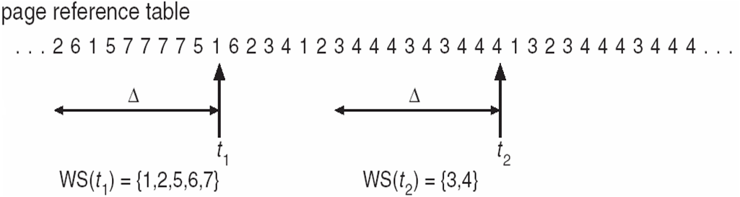
Working-set Model
Working set window (Δ)
Δ ≡ a fixed number of previous page references (say 10)
Performance depends on Δ
if Δ too small will not encompass entire locality
if Δ too large will encompass several localities
if Δ = ∞ ⇒ will encompass entire program
Idle page time (T)
Pages with idle time less than T are in the working set.
Working-Set model prevents thrashing while keeping the degree of multiprogramming as high as possible.

Slide 45
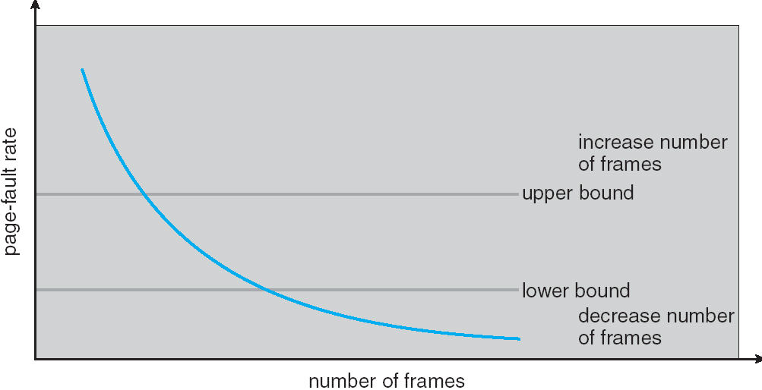
Page-Fault Frequency Scheme
Establish “acceptable” page-fault rate
If actual rate too low, process loses frame
If actual rate too high, process gains frame

